Slide 1
PHP Arrays and Superglobals
Chapter 9

Slide 2
Objectives
1
2
Arrays
$_GET and $_POST Superglobal arrays
3
4
$_SERVER Array
$_FILES Array
5
Reading/Writing Files
7

Slide 3
Arrays
Section 1 of 5

Slide 4
Arrays
Background
An array is a data structure that
Collects a number of related elements together in a single variable.
Allows the set to be Iterated
Allows access of any element
Since PHP implements an array as a dynamic structure:
Add to the array
Remove from the array

Slide 5
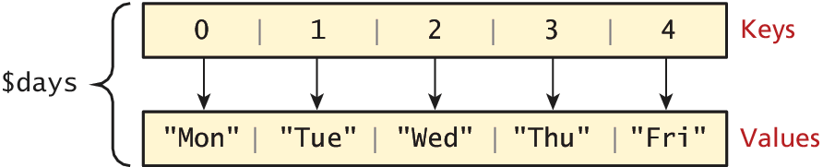
Arrays
Key Value
In PHP an array is actually an ordered map, which associates each value in the array with a key.

Slide 6
Arrays
Keys
Array keys are the means by which you reer to s ingle element in the array.
In most programming languages array keys are limited to integers, start at 0, and go up by 1.
In PHP, array keys must be either integers or strings and need not be sequential.
Don’t mix key types i.e. “1” vs 1
If you don’t explicitly define them they are 0,1,…

Slide 7
Arrays
Values
Array values, unlike keys, are not restricted to integers and strings.
They can be any object, type, or primitive supported in PHP.
You can even have objects of your own types, so long as the keys in the array are integers and strings.

Slide 8
Arrays
Defining an array
The following declares an empty array named days:
$days = array();
You can also initialize it with a comma-delimited list of values inside the ( ) braces using either of two following syntaxes:
$days = array("Mon","Tue","Wed","Thu","Fri");
$days = ["Mon","Tue","Wed","Thu","Fri"]; // alternate

Slide 9
Arrays
Defining an array
You can also declare each subsequent element in the array individually:
$days = array();
$days[0] = "Mon"; //set 0th key’s value to “Mon”
$days[1] = "Tue";
// also alternate approach
$daysB = array();
$daysB[] = "Mon"; //set the next sequential value to “Mon”
$daysB[] = "Tue";

Slide 10
Arrays
Access values
To access values in an array you refer to their key using the square bracket notation.
echo "Value at index 1 is ". $days[1];

Slide 11
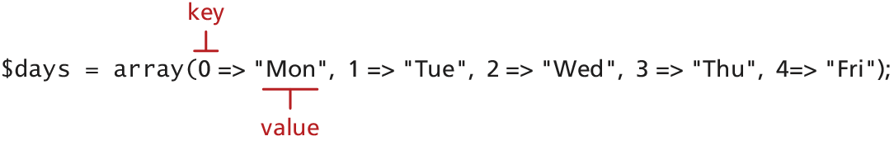
Keys and Values
In PHP, you are also able to explicitly define the keys in addition to the values.
This allows you to use keys other than the classic 0, 1, 2, . . . , n to define the indexes of an array.

Slide 12
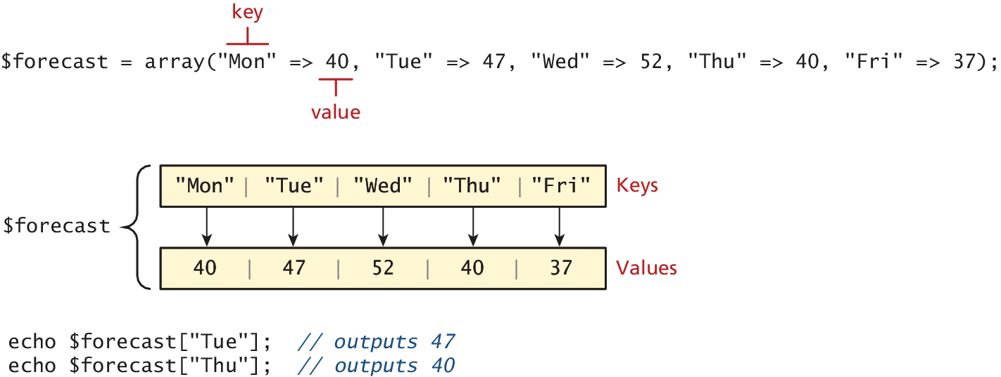
Super Explicit
Array declaration with string keys, integer values

Slide 13
Multidimensional Arrays
Creation
$month = array(
array("Mon","Tue","Wed","Thu","Fri"),
array("Mon","Tue","Wed","Thu","Fri"),
array("Mon","Tue","Wed","Thu","Fri"),
array("Mon","Tue","Wed","Thu","Fri")
);
echo $month[0][3]; // outputs Thu

Slide 14
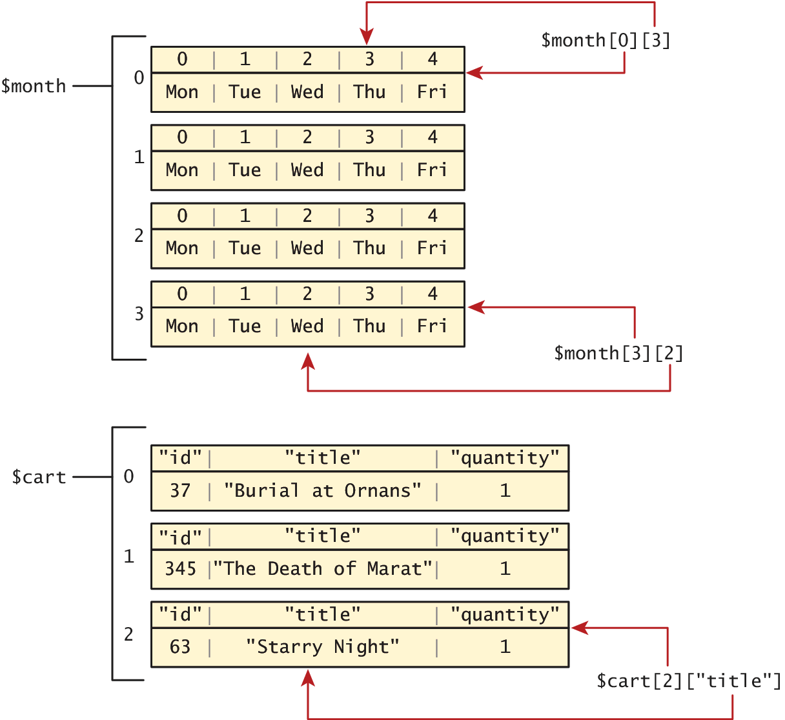
Multidimensional Arrays
Access

Slide 15
Multidimensional Arrays
Another example
$cart = array();
$cart[] = array("id" => 37, "title" => "Burial at Ornans", "quantity" => 1);
$cart[] = array("id" => 345, "title" => "The Death of Marat", "quantity" => 1);
$cart[] = array("id" => 63, "title" => "Starry Night", "quantity" => 1);

Slide 16
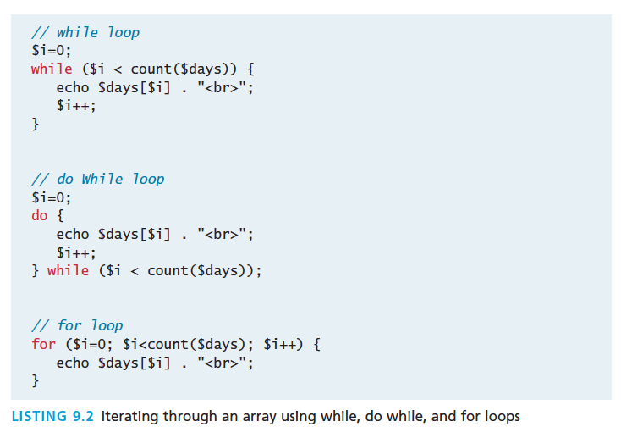
Iterating through an array

Slide 17
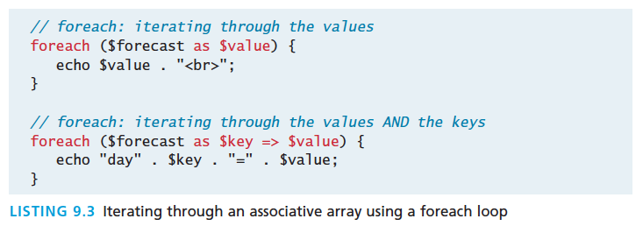
Iterating through an array
Foreach loop is pretty nice
The challenge of using the classic loop structures is that when you have nonsequential integer keys (i.e., an associative array), you can’t write a simple loop that uses the $i++ construct. To address the dynamic nature of such arrays, you have to use iterators to move through such an array.

Slide 18
Adding to an array
To an array
An element can be added to an array simply by using a key/index that hasn’t been used
$days[5] = "Sat";
A new element can be added to the end of any array
$days[ ] = "Sun";

Slide 19
Adding to an array
And quickly printing
PHP is more than happy to let you “skip” an index
$days = array("Mon","Tue","Wed","Thu","Fri");
$days[7] = "Sat";
print_r($days);
Array ([0] => Mon [1] => Tue [2] => Wed [3] => Thu [4] => Fri [7] => Sat)’
If we try referencing $days[6], it will return a NULL value

Slide 20
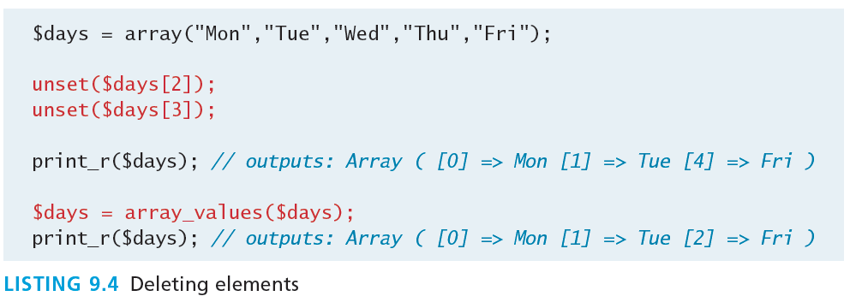
Deleting from an array
You can explicitly delete array elements using the unset() function

Slide 21
Deleting from an array
You can explicitly delete array elements using the unset() function.
array_values() reindexes the array numerically

Slide 22
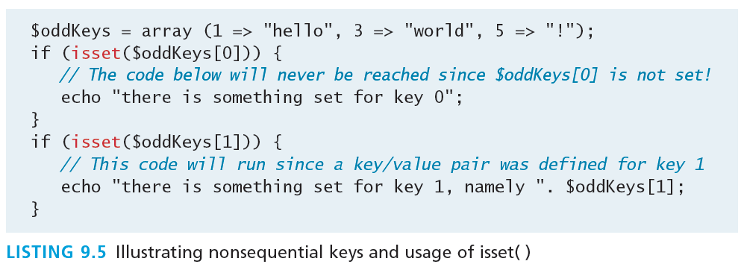
Checking for a value
Since array keys need not be sequential, and need not be integers, you may run into a scenario where you want to check if a value has been set for a particular key.
To check if a value exists for a key, you can therefore use the isset() function, which returns true if a value has been set, and false otherwise

Slide 23
Array Sorting
Sort it out
There are many built-in sort functions, which sort by key or by value. To sort the $days array by its values you would simply use:
sort($days);
As the values are all strings, the resulting array would be:
Array ([0] => Fri [1] => Mon [2] => Sat [3] => Sun [4] => Thu [5] => Tue [6] => Wed)
A better sort, one that would have kept keys and values associated together, is:
asort($days);
Array ([4] => Fri [0] => Mon [5] => Sat [6] => Sun [3] => Thu [1] => Tue [2] => Wed)

Slide 24
More array operations
Too many to go over in depth here…
array_keys($someArray)
array_values($someArray)
array_rand($someArray, $num=1)
array_reverse($someArray)
array_walk($someArray, $callback, optionalParam)
in_array($needle, $haystack)
shuffle($someArray)
…

Slide 25
$_GET and $_POST Superglobal arrays
Section 2 of 5

Slide 26
Superglobal Arrays
PHP uses special predefined associative arrays called superglobal variables that allow the programmer to easily access HTTP headers, query string parameters, and other commonly needed information.
They are called superglobal because they are always in scope, and always defined.

Slide 27
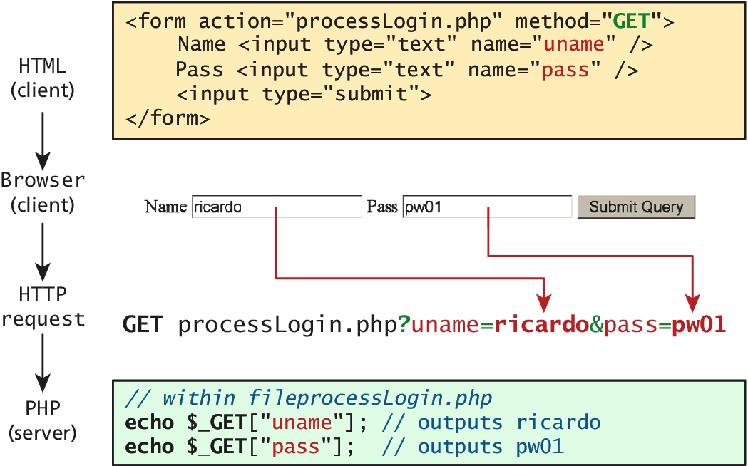
$_GET and $_POST
Sound familiar?
The $_GET and $_POST arrays are the most important superglobal variables in PHP since they allow the programmer to access data sent by the client in a query string.

Slide 28
$_GET and $_POST
Sound familiar?
Get requests parse query strings into the $_GET array
Post requests are parsed into the $POST array
This mechanism greatly simplifies accessing the data posted by the user, since you need not parse the query string or the POST request headers!

Slide 29
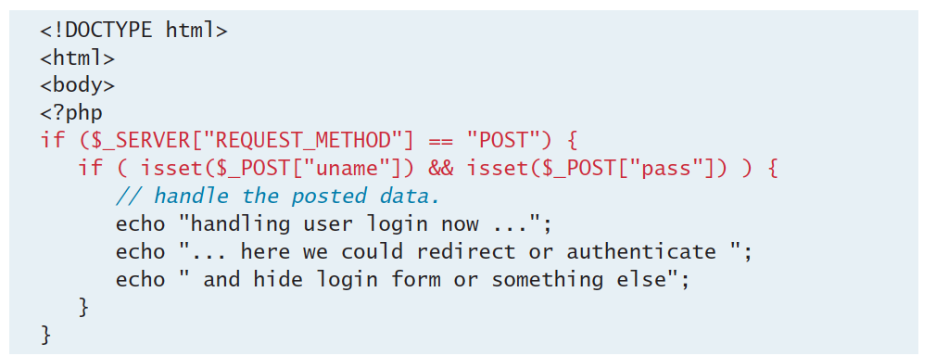
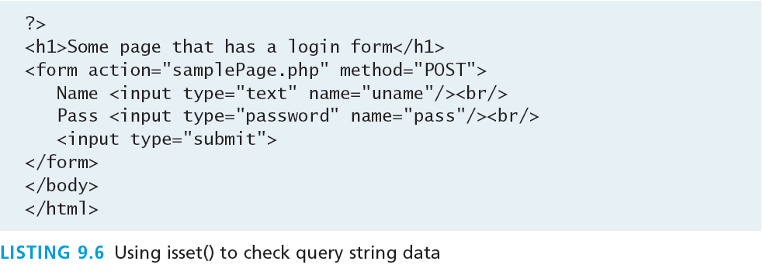
Determine if any data sent

Slide 30
Determine if any data sent
Isset()

Slide 31
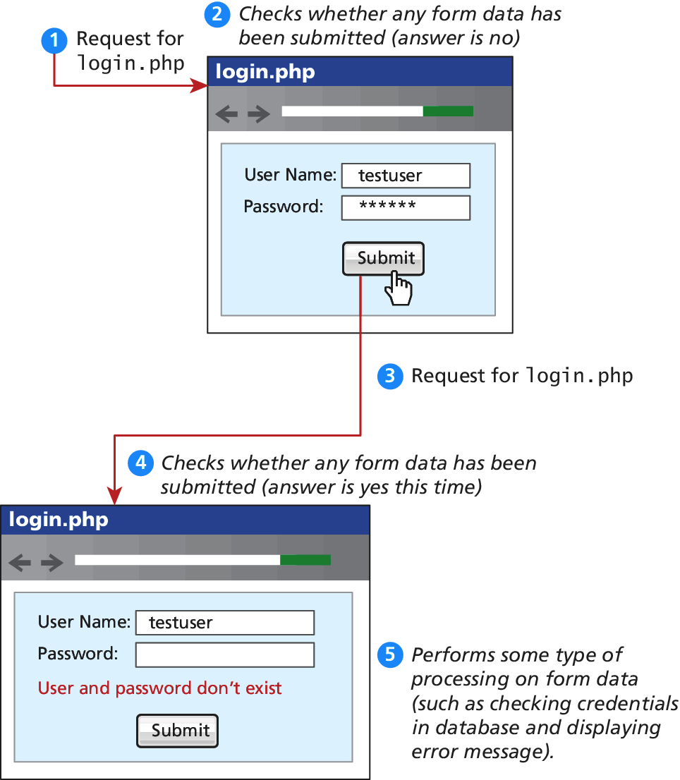
Determine if any data sent

Slide 32
Determine if any data sent
Isset()

Slide 33
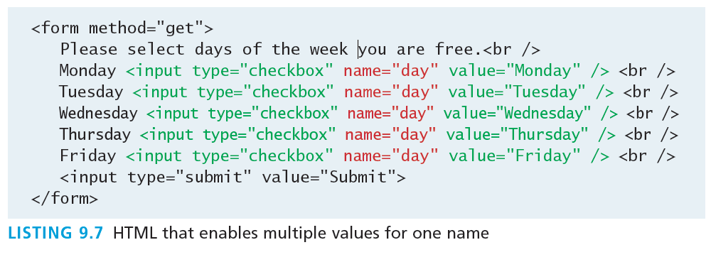
Accessing Form Array Data
Sometimes in HTML forms you might have multiple values associated with a single name;

Slide 34
Accessing Form Array Data
HTML tweaks for arrays of data
Unfortunately, if the user selects more than one day and submits the form, the $_GET['day'] value in the superglobal array will only contain the last value from the list that was selected.
To overcome this limitation, you must change the name attribute for each checkbox from day to day[].
Monday <input type="checkbox" name="day[]" value="Monday" />
Tuesday <input type="checkbox" name="day[]" value="Tuesday" />

Slide 35
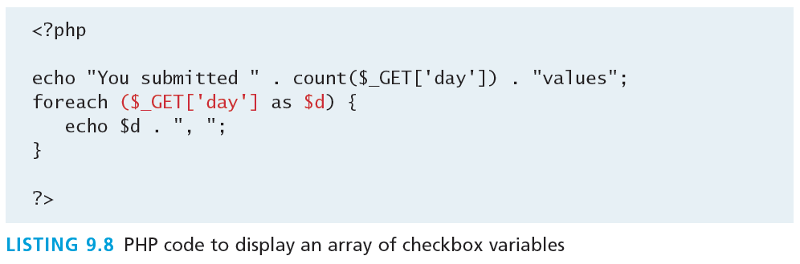
Accessing Form Array Data
Meanwhile on the server
After making this change in the HTML, the corresponding variable $_GET['day'] will now have a value that is of type array.

Slide 36
Using Query String in Links
Design idea
Imagine a web page in which we are displaying a list of book links. One approach would be to have a separate page for each book.

Slide 37
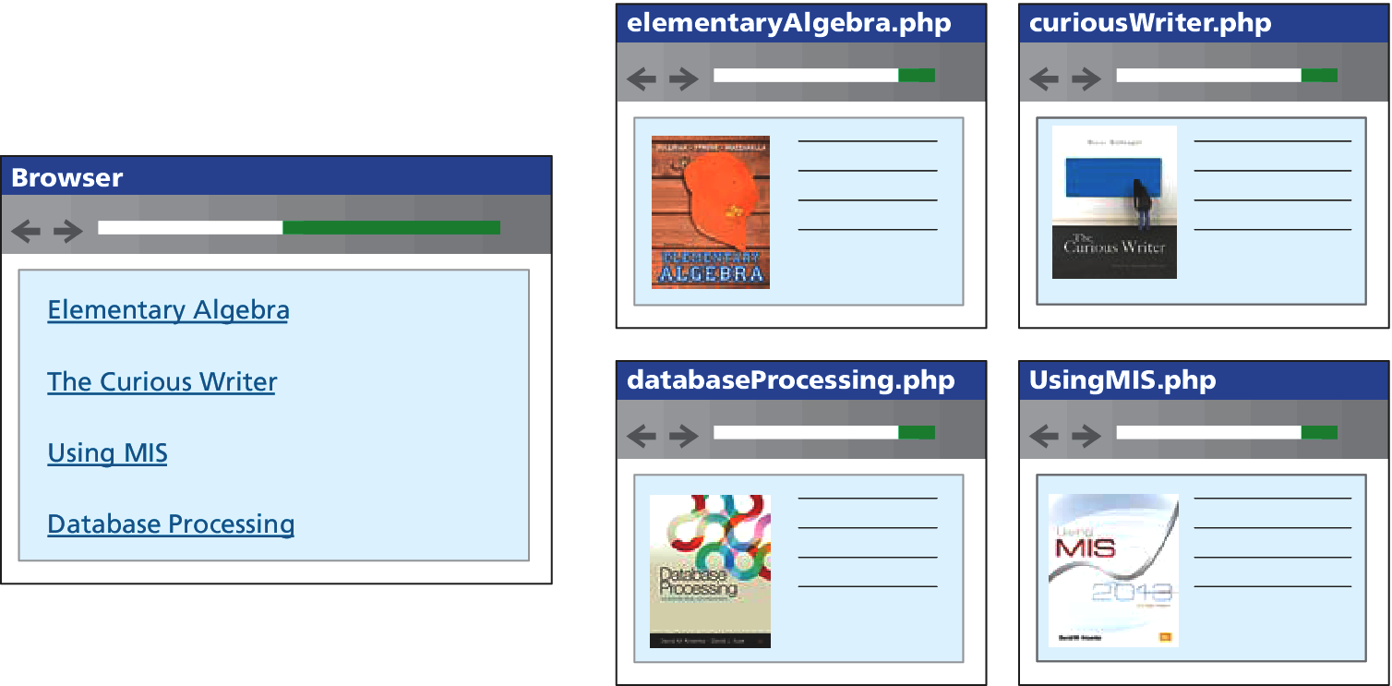
Using Query Strings in links
Not a great setup

Slide 38
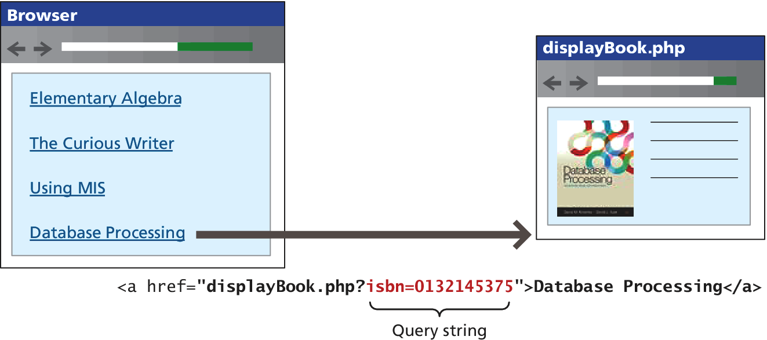
Using Query Strings in links
Use the query string to reduce code duplication

Slide 39
Sanitizing Query Strings
Just because you are expecting a proper query string, doesn’t mean that you are going to get a properly constructed query string.
distrust all user input
The process of checking user input for incorrect or missing information is sometimes referred to as the process of sanitizing user inputs.
Learn more about this in Chapter 11/12.

Slide 40
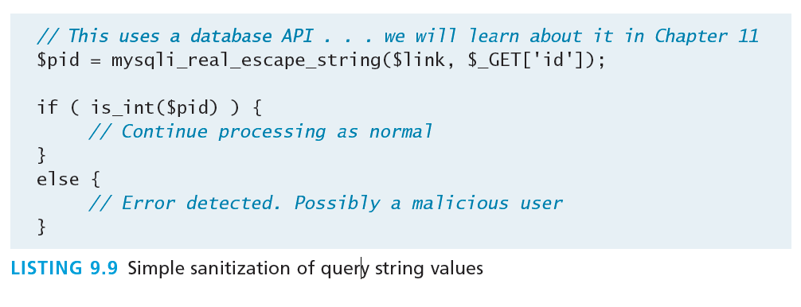
Sanitation
Don’t forget trim()

Slide 41
$_SERVER array
Section 3 of 5

Slide 42
$_SERVER
The $_SERVER associative array contains
HTTP request headers (send by client)
configuration options for PHP
To use the $_SERVER array, you simply refer to the relevant case-sensitive keyname:
echo $_SERVER["SERVER_NAME"] . "<br/>";
echo $_SERVER["SERVER_SOFTWARE"] . "<br/>";
echo $_SERVER["REMOTE_ADDR"] . "<br/>";

Slide 43
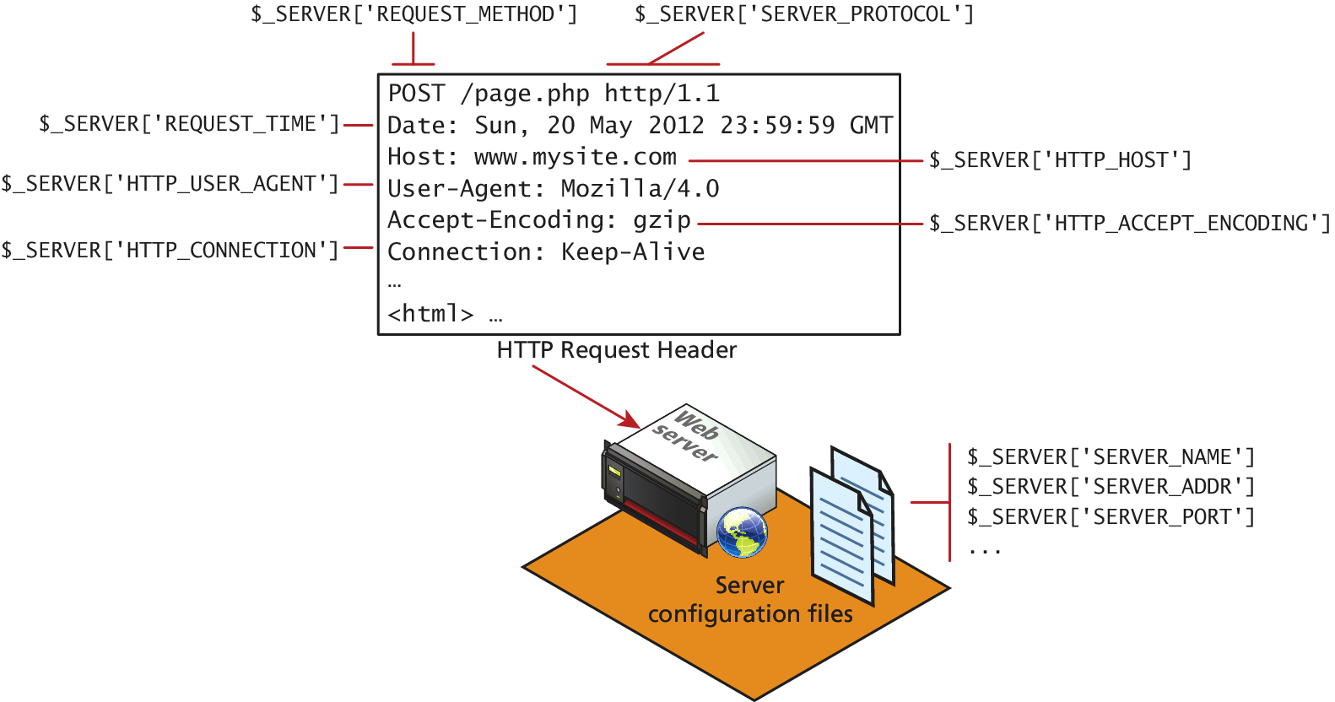
$_SERVER

Slide 44
SERVER INFORMATION KEYS
SERVER_NAME contains the name of the site that was requested
SERVER_ADDR tells us the IP of the server
DOCUMENT_ROOT tells us the location from which you are currently running your script
SCRIPT_NAME key that identifies the actual script being executed

Slide 45
Request Header Keys
REQUEST_METHOD returns the request method that was used to access the page: that is, GET, HEAD, POST, PUT
REMOTE_ADDR key returns the IP address of the requestor
HTTP_USER_AGENT contains the operating system and browser that the client is using
HTTP_REFERER contains the address of the page that referred us to this one (if any) through a link

Slide 46
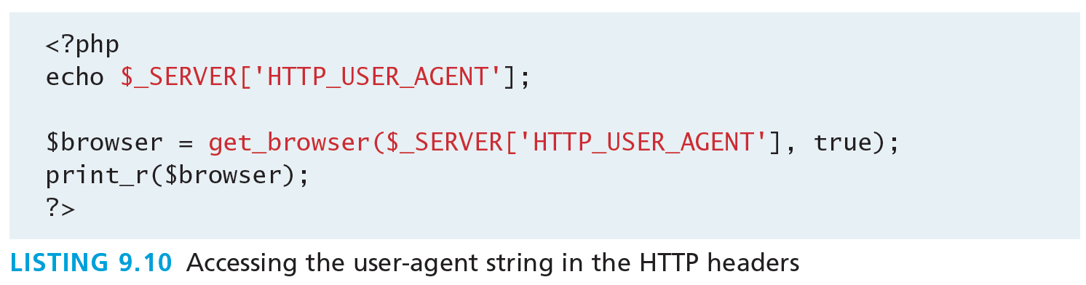
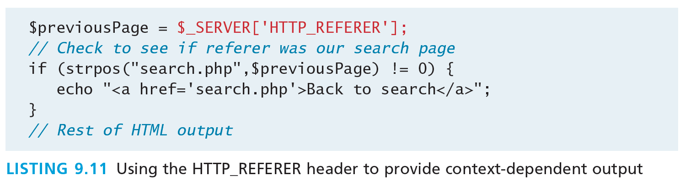
Header Access Examples

Slide 47
Security
Headers can be forged
All headers can be forged!
The HTTP_REFERER header can lie about where the referral came from
The USER_AGENT can lie about the operating system and browser the client is using.

Slide 48
$_FILES array
Section 4 of 5

Slide 49
$_FILES Array
The $_FILES associative array contains items that have been uploaded in the current request.
A server script must process the upload file(s) in some way; the $_FILES array helps in this process.
the $_FILES array will contain a key=value pair for each file uploaded in the post
First a refresher on HTML forms for uploading files…

Slide 50
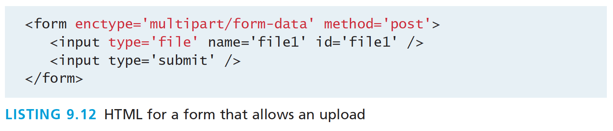
HTML Required for File Uploads
You must ensure that the HTML form uses the HTTP POST method, since transmitting a file through the URL is not possible.
You must add the enctype="multipart/form-data" attribute to the HTML form that is performing the upload so that the HTTP request can
You must include an input type of file in your form.

Slide 51
Handling File upload in PHP
The $_FILES array will contain a key=value pair for each file uploaded in the post.
The key for each element will be the name attribute from the HTML form, while the value will be an array containing information about the file as well as the file itself.
The keys in that array are the name, type, tmp_name, error, and size.

Slide 52
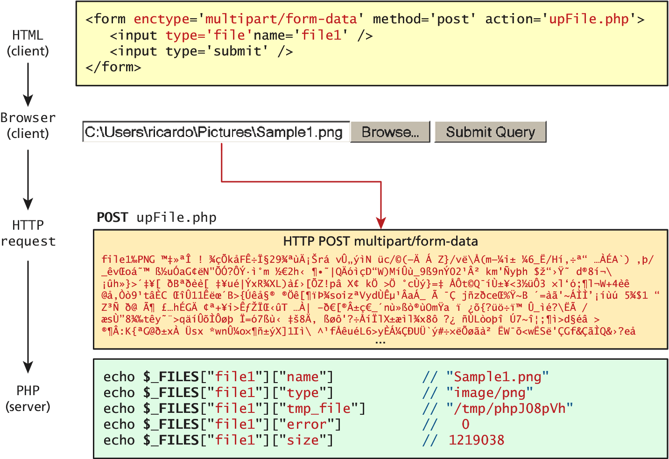
Handling File upload in PHP

Slide 53
Handling File upload in PHP
Keys. We still have to do something with this data
name is a string containing the full file name used on the client machine, including any file extension.
type defines the MIME type of the file
tmp_name is the full path to the location on your server where the file is being temporarily stored.
error is an integer that encodes many possible errors and is set to UPLOAD_ERR_OK (integer value 0) if the file was uploaded successfully.
size is an integer representing the size in bytes of the uploaded file.

Slide 54
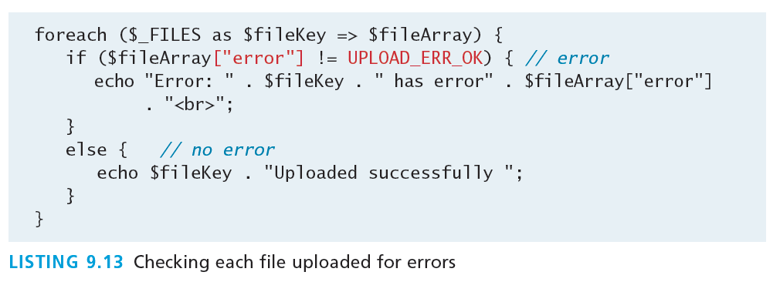
Check for errors
For every uploaded file, there is an error value associated with it in the $_FILES array.
The value for a successful upload is UPLOAD_ERR_OK, and should be looked for before proceeding any further.

Slide 55
Check for errors
For every uploaded file, there is an error value associated with it in the $_FILES array.
The value for a successful upload is UPLOAD_ERR_OK, and should be looked for before proceeding any further.

Slide 56
File Size Restrictions
There are three main mechanisms for maintaining uploaded file size restrictions:
HTML in the input form
via JavaScript in the input form
via PHP coding.

Slide 57
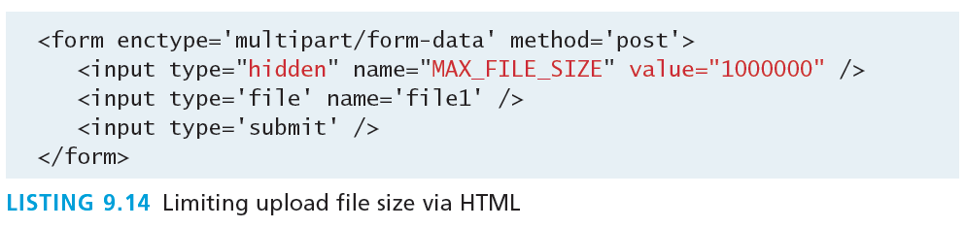
HTML in the input form
Add an hidden input field before any other input fields in your HTML form with a name of MAX_FILE_SIZE
The file uploading must be complete before an error message can be received.

Slide 58
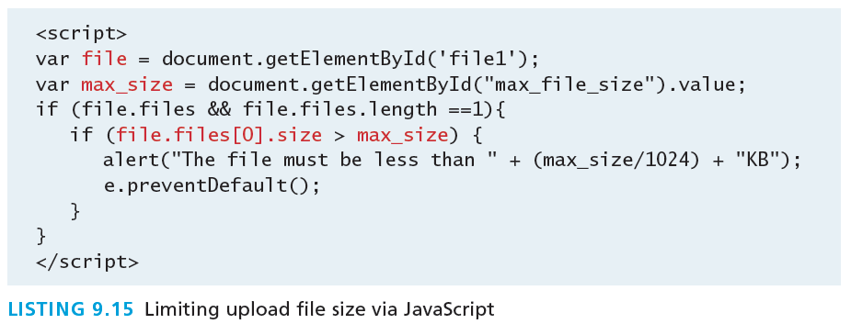
Via JavaScript
Allows a client side check to happen before any data transmitted. (Easily overridden).

Slide 59
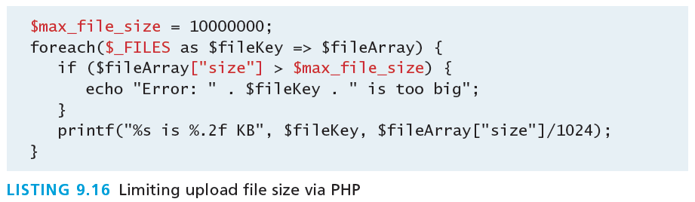
via PHP
The only one you HAVE to do.
The third mechanism for limiting the uploaded file size is to add a simple check on the server side (just in case JavaScript was turned off or the user modified the MAX_FILE_SIZE hidden field).

Slide 60
Limiting the type of File Upload
I won’t allow .abc, .def now let me be
What if you wanted the user to upload an image and they uploaded a Microsoft Word document?
You might also want to limit the uploaded image to certain image types, such as jpg and png, while disallowing bmp and others.
examine the file extension
and the type field

Slide 61
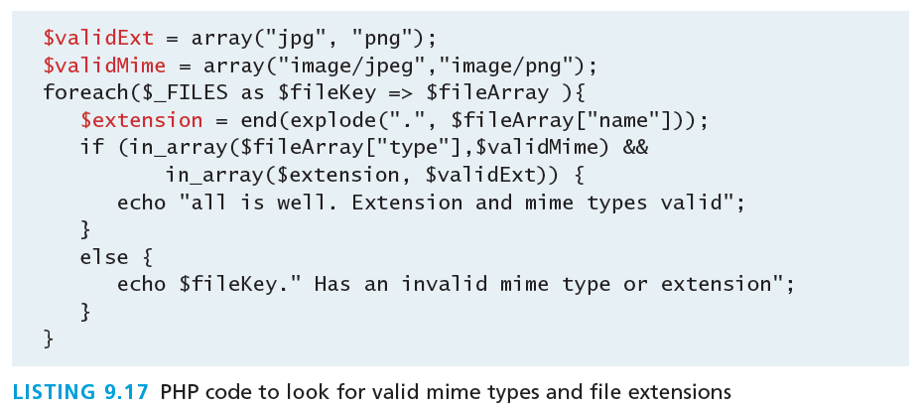
Limiting the type of File Upload
Example code

Slide 62
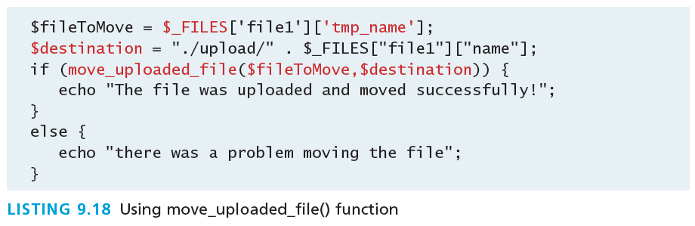
Moving the File
Finally!
You must move the temporary file to a permanent location on your server.
move_uploaded_file() takes in the temporary file location and the file’s final destination.

Slide 63
READING/WRITING Files
Section 5 of 5

Slide 64
Reading/Writing
There are two basic techniques for read/writing files in PHP:
Stream access. In this technique, our code will read just a small portion of the file at a time. While this does require more careful programming, it is the most memory-efficient approach when reading very large files.
All-In-Memory access. In this technique, we can read the entire file into memory. While not appropriate for large files, it does make processing of the file extremely easy.

Slide 65
Stream Access
C style
C style file access. More difficult, but more memory efficient.
The function fopen() takes a file location or URL and access mode as parameters. The returned value is a stream resource, which you can then read sequentially.
Use fread() or fgets() to read ahead in the file. Fclose() is invoked when you are done.
Writing done much the same with fwrite().

Slide 66
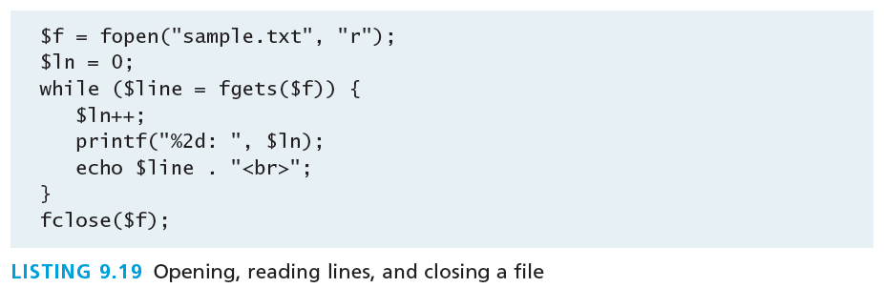
Stream Access
Just show me the code

Slide 67
In-Memory File Access
Easy as pie
file() Reads the entire file into an array, with each array element corresponding to one line in the file
file_get_contents() reads the entire file into a string variable
file_put_contents() writes the contents of a string variable out to a file

Slide 68
In-Memory File Access
To read an entire file into a variable you simply use:
$fileAsString = file_get_contents(FILENAME);
To write the contents of a string $writeme to a file:
file_put_contents(FILENAME, $writeme);

Slide 69
In-Memory File Access
Consider a realistic example
imagine we have a comma-delimited text file that contains information about paintings, where each line in the file corresponds to a different painting:
01070,Picasso,The Actor,1904
01080,Picasso,Family of Saltimbanques,1905
02070,Matisse,The Red Madras Headdress,1907
05010,David,The Oath of the Horatii,1784

Slide 70
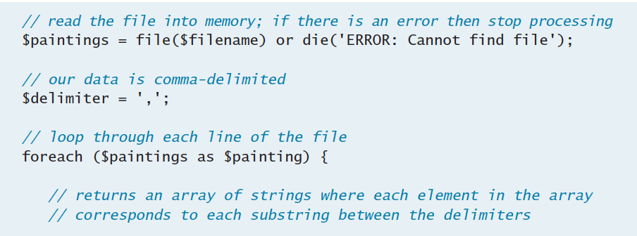
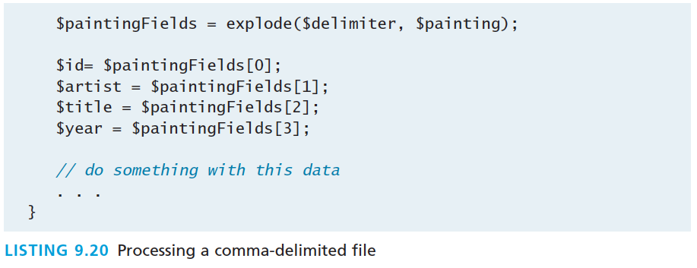
In-Memory File Access
Parsing our file

Slide 71
What You’ve Learned
1
2
Arrays
$_GET and $_POST Superglobal arrays
3
4
$_SERVER Array
$_FILES Array
5
Reading/Writing Files
7

